Slide 1
Year 11 Revision Evening

Slide 2
Why Parent Engagement matters
There is an established link between the home learning environment and children’s performance at school
We have a shared priority to deliver the best outcomes for our children
The average impact of parental engagement is +4 months’ progress over the course of a year (2 years in total for Secondary School)
However.....
Working effectively with children can be challenging, and is likely to require sustained effort and support (2-way process)

Slide 3
Aims for this evening
Provide a brief overview of the Year 11 GCSE exams process with key dates
To outline expectations of students
To provide guidance on how you can support your child in:
  English
  Maths
  Science
Suggest ways in which parents can support students to reach their full potential

Slide 4
Key Dates – GCSE Roadmap 2025-26
Date | Event
10th October | PPE (Mock) Assembly launch with packs + start of afterschool revision
13th October | Revision Evening
3rd November | PPE's Start (Mocks) - 2 Week window
WB 8th December | Brown Envelope
WB 15th January | 1-1 Progress Meetings
29th January – 2nd February | Post-16 Subject Taster Week
5th – 9th February | Statement of Entry sent home
23rd Feb – 6th March | PPE's 2 Start (Mocks) - 2 Week Window + Cycle
Spring Term | Post-16 Futures Meetings (optional on request)
6th May | Written GCSE Exams begin
25th June | Written GCSE Exams end
WB 2nd July | Year 11 Prom
20th August | GCSE Results Day and Sixth Form Sign-up

Slide 5
Key Dates – GCSE Roadmap 2025-26
Study Leave – our aim is to make every moment and lesson matters. No formal study leave
GCSE Master Classes
PM Registrations/Intervention sessions for Core subjects
Exams Preparation (Guidance)
Clear pencil case – multiple pens and pencils; scientific calculator if allowed
No Smart Devices – phones/watches
Malpractice – if they cheat or disrupt an exam, they can be withdrawn from all exams for that exam board
Attendance – is imperative this year. If you are in the lesson, you can still learn and prepare.
Exam arrangements - a lot of arrangements have already been put into place after Yr 10 PPEs. These will be considered again for all PPEs and final examinations.

Slide 6
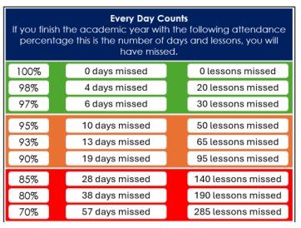
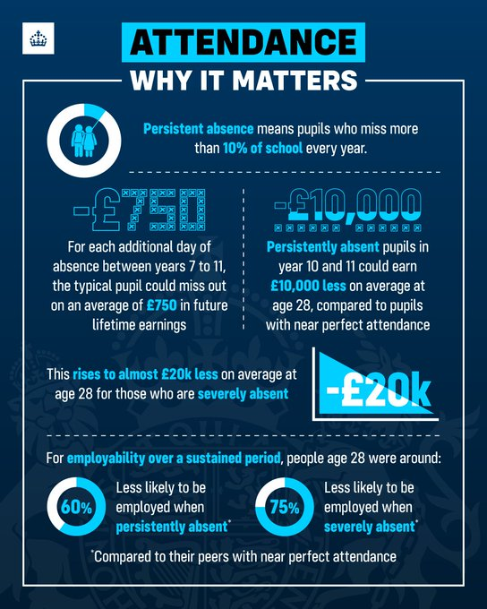
Attendance
Research shows that 17 days missed from school equates to a whole GCSE grade difference (that’s 91% attendance)
Students with 100% attendance:
  Over twice as likely to achieve
  5+ GCSEs Grade 4-9 including
  English and Maths.

Slide 7

Being successful in Y11 – We are a partnership!
Ensuring success
Raising aspirations
Unlocking potential

Slide 8

Role of the parent
Help them to get organised
Create a good working environment
Organised desk
Revision timetable and dates for deadlines
Books, resources and revision guides
Useful “facts” posters on the walls
Clock
Drinks and snacks space
Quiet- no distractions!

Slide 9
Revision & Exam Preparation
Start NOW!
Ensure they have all the necessary equipment and revision guides/materials
Recognise their strengths but keep your expectations high
Recognise areas for development and make sure the expectations are high yet manageable for all of you
Keep in touch – with subject teachers, and tutors

Slide 10
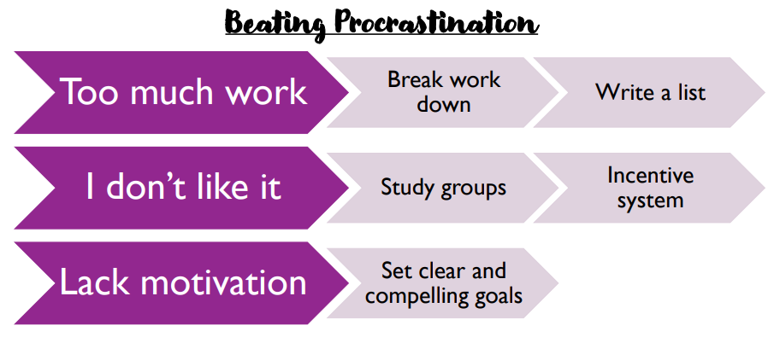
Revision & Exam preparation

Slide 11
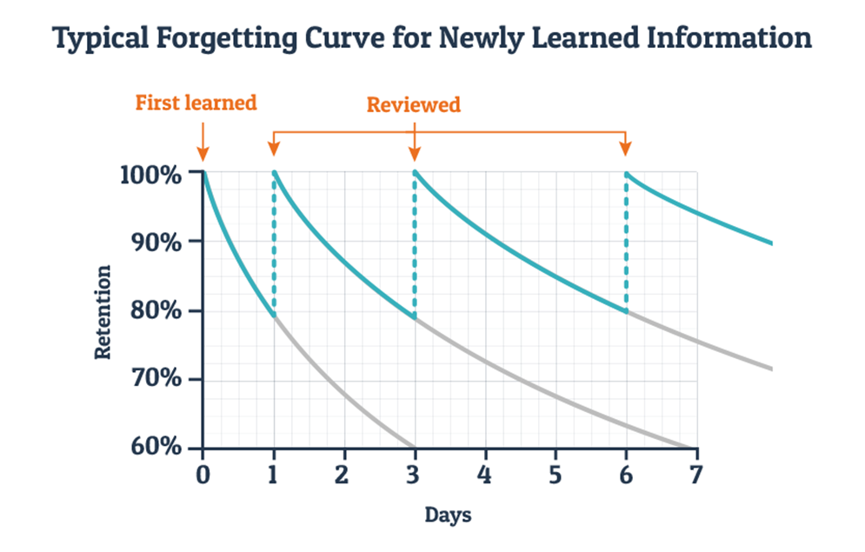
Spaced Retrieval is key
Revisit learning at regular intervals
Speed of retrieval increases the more you revisit information
Revisiting information now will increase retrieval in an exam situation

Slide 12
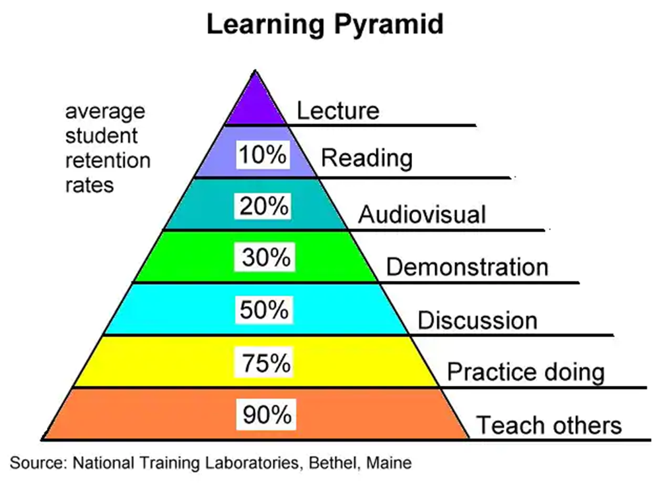
How we revise is crucial
Simply reading from a revision guide or notes will have minimal retention/impact
All the methods that have over 50% retention rate involve someone else helping the child – this is likely to be you as their parent (no matter how much they protest!)

Slide 13



Helpful Apps & Websites

Slide 14
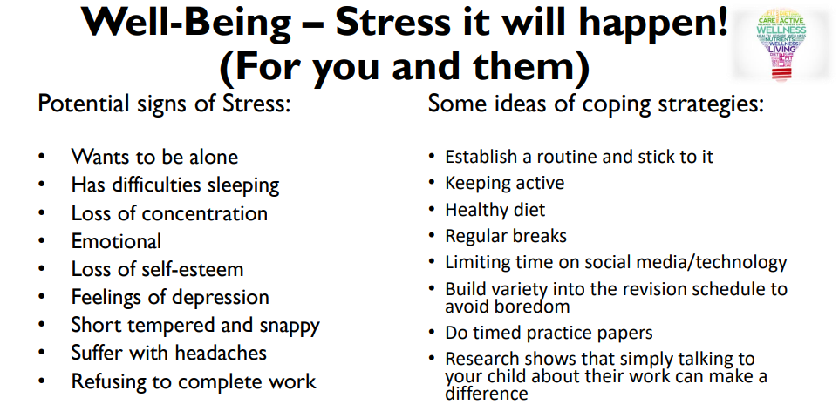

Slide 15
Revision cards
For each topic:
  Use revision guides/ notes/ checklists to:
    Identify key words.
Make a card with information about this key word on.
Diffusion
Definition:
Picture:

Slide 16
Revision cards
Question
Answer
Diagram/ graph
Explanation of what this is showing
Key information about topics you really struggle with
Exam tips- key scientific words to use

Slide 17
How to use revision cards
Get a friend/ parent (they will love to help) to read one side of a card, you give them the answer.
Test yourself by reading a key word and working out answer. Check you are correct.
Cards you get correct at least twice go to the bottom of the pile so you have more difficult ones to test regularly.

Slide 18

Mind maps
Choose a topic.
Break that topic into subtopics.
Branch out each subject to expand the key ideas using questions, definitions, pictures and colour.

Slide 19
Key word glossaries
Make a glossary of key terms.
Use this when doing exam questions.
Word | Picture | Meaning
density |  | How tightly packed the particles are.
diffusion |  | Particles spreading out to fill the space available.
particle |  | Tiny things that everything is made from.
state |  | Whether something is a solid, a liquid or a gas.
concentration |  | How many particles there are in a specific volume of liquid.
condensation |  | Change from a gas to a liquid e.g. steam turning into water on a bathroom mirror.
Notes:
Can cut up to use as a card sort.

Slide 20
Past paper/ exam style questions
Try to answer:
  Exam conditions
  Open book
Questions to test your understanding.
Mark them using the mark scheme.
Correct them to learn from them.
If you got it wrong work out why!
Notes:
Go through why it is important to work out why you got things wrong.

Slide 21
Other
Mnemonics.
Silly stories.
Keep practicing… you may not get it first time but if you keep going, it will happen.
If you don’t understand it, don’t panic just learn the key words and you still could get full marks in a question on it.

Slide 22
Strategies for success in exams
Highlight command words and information.
Look at how many marks a question is worth.
Bullet point answers to try to make sure you make clear points.
Think about key words to include in an answer before you start writing.
Show your working for calculations and include units.
If it seems straightforward don’t doubt it, some questions will be easier than you expect.
Don’t rush when you are finding numbers from a graph.
Notes:
Retype calculations/ essentially redo paper.

Slide 23
Sturminster Newton Sixth Form
Sixth Form Team – Mr Ling, Mrs Privett
Young people are required to remain in education, work place training until the age of 18
If you would like a meeting with the Head of Sixth Form to explore the post-16 options for your young person, please email: office@mysnhs.net
Thursday 13th November – Sixth Form Destinations and Open Evening, 5pm to 7pm

Slide 24
Key Contacts
Miss K Allen – Head of Year 10 and Year 11
Mrs S Hoffman – SENDCo
Mrs E Brooks– Exams Officer
Mr P Dodman – Careers Lead
Mr S Ling – Executive Head of Sixth Form
Dr K King – Head of Science
Mr J Hawkins – Head of English
Mr S Miller – Lead in Maths
Mrs L Woods – Head of MFL
All contactable on: office@mysnhs.net

Slide 25


