Slide 1
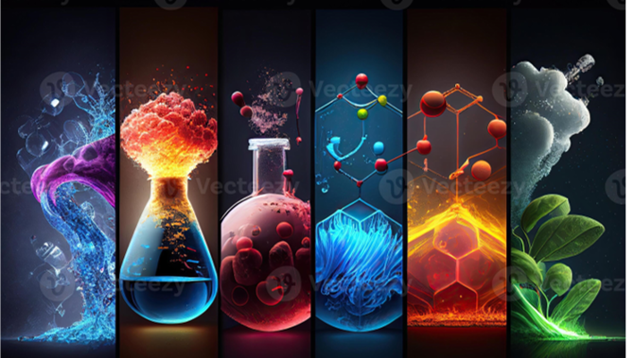
Y11 Science

Slide 2

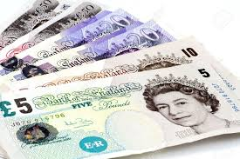
Why revise Science?
It is a ‘Core’ Subject along with English and Maths – employers look at these subjects.
It counts for 2 (or 3!) GCSES!
It might be needed for future qualifications.
It might affect the career you end up doing.

Slide 3

Which exam board? Which exams??
AQA Triple Science (separate Sciences)
6 x 1hour 45 min papers
AQA Combined Science: Trilogy
6 x 1hour 15 min papers

Slide 4
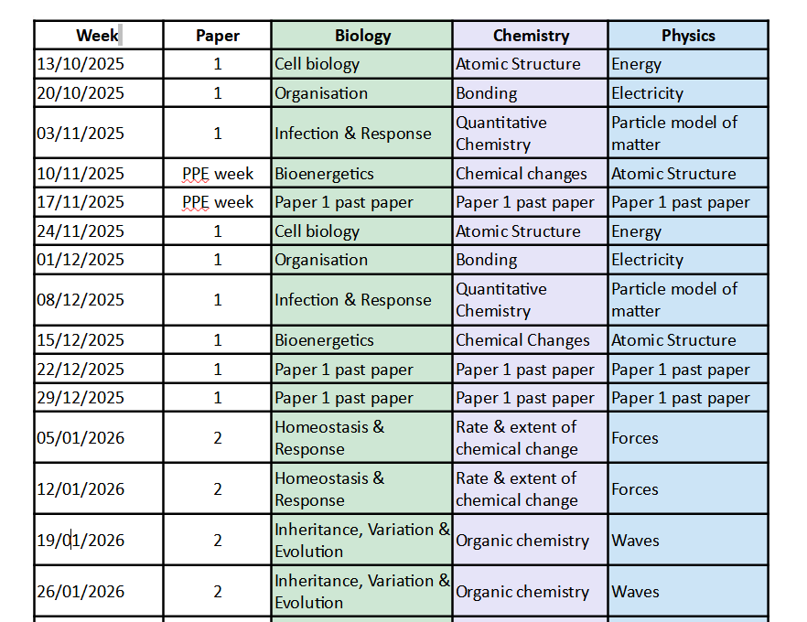

Slide 5
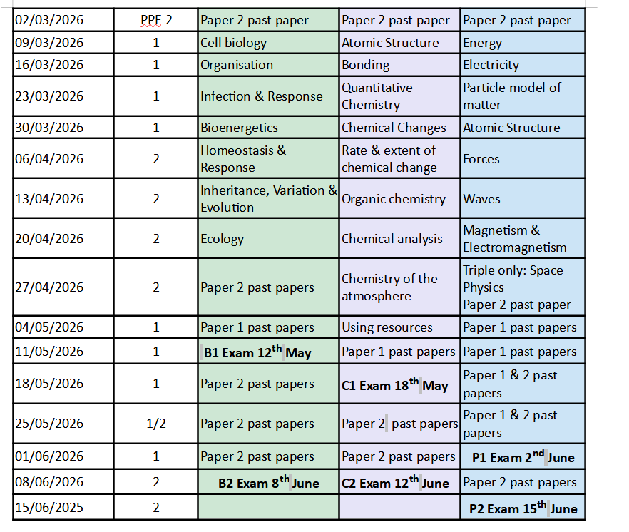

Slide 6

My GCSE Science - Premium video tutorials, exam-style questions and revision resources

Slide 7
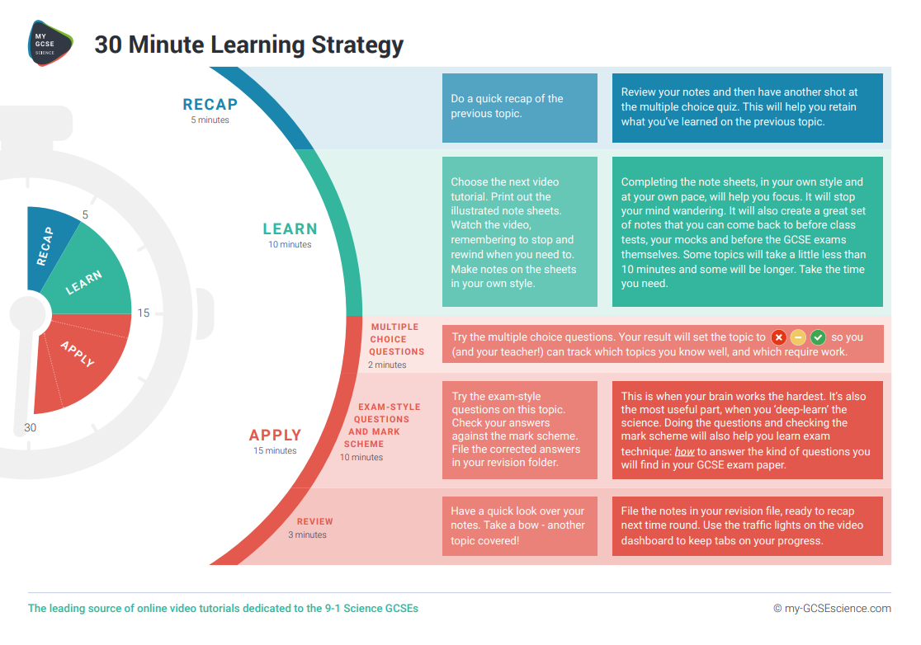

Slide 8





Useful Apps and websites
physics and maths tutor past papers - Search
AQA | Resources | Past Papers & AQA Mark Schemes
https://www.bbc.co.uk/bitesize/examspecs/z8r997h
https://studymind.co.uk/resource/aqa-biology/

Slide 9
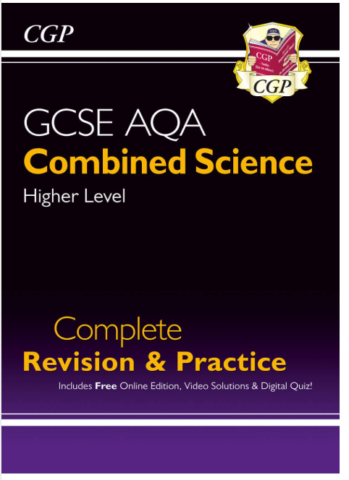
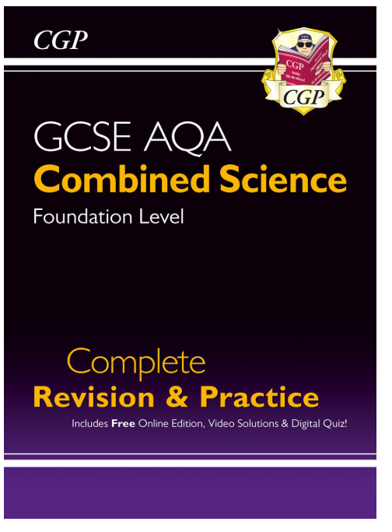
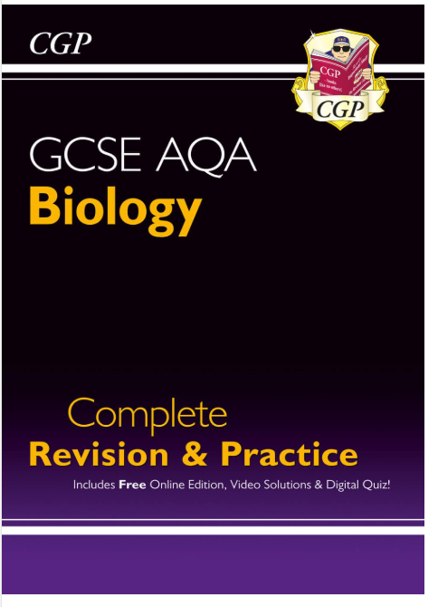
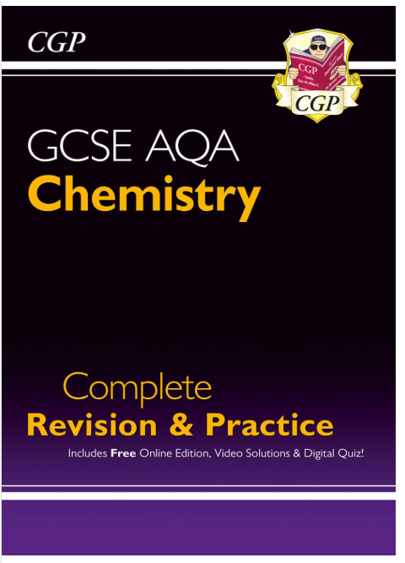
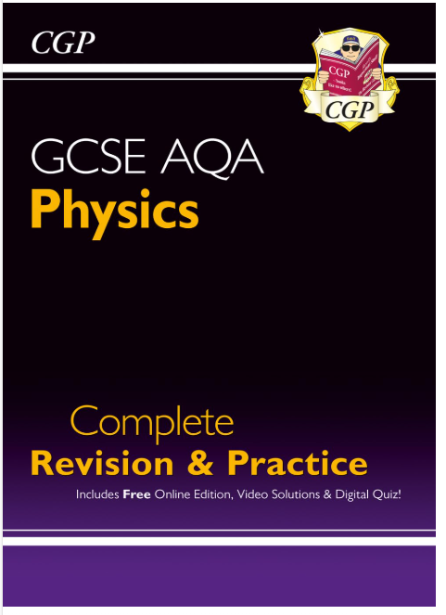
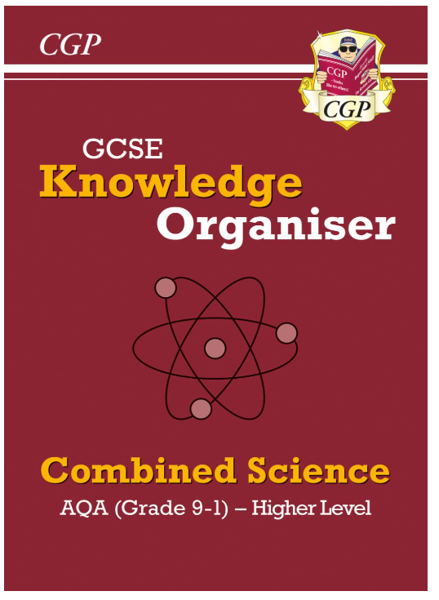
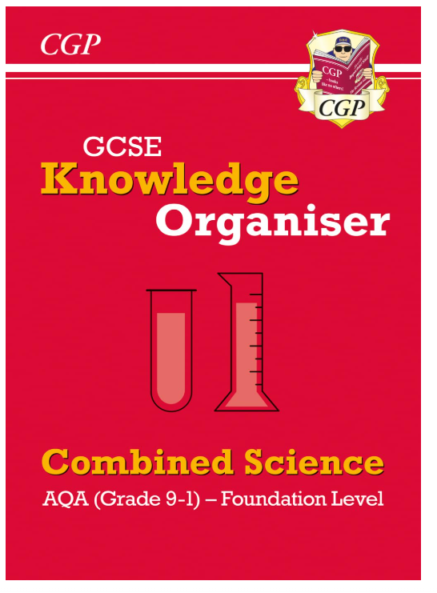
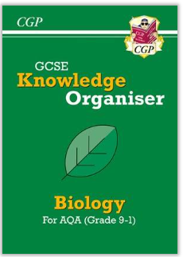
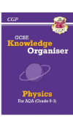
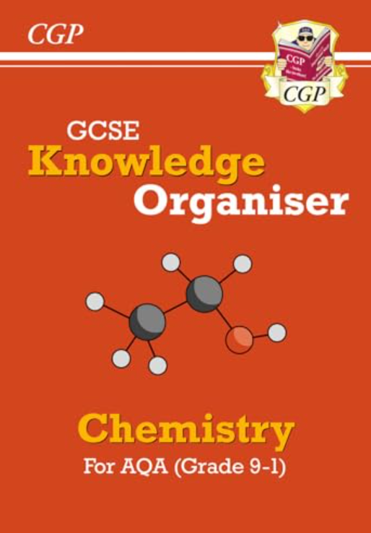
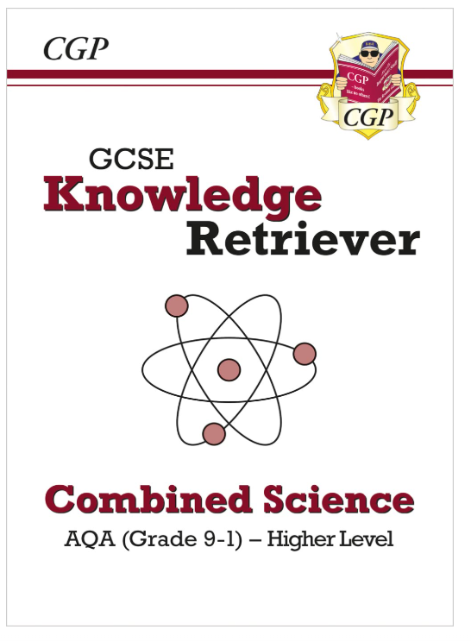
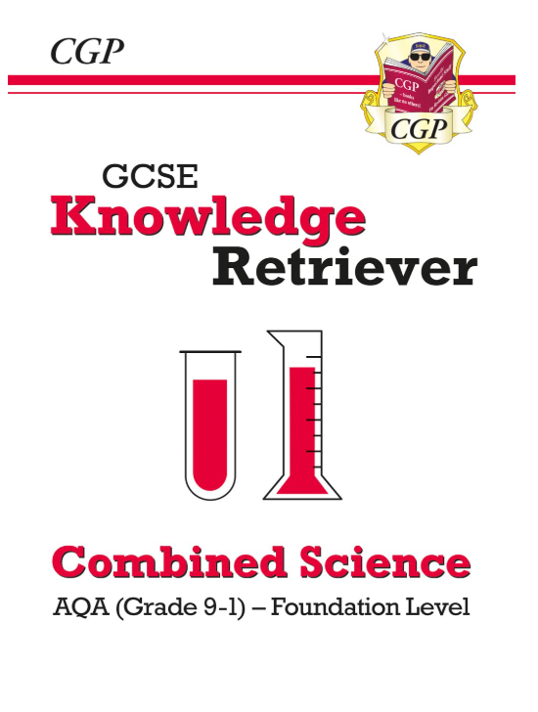
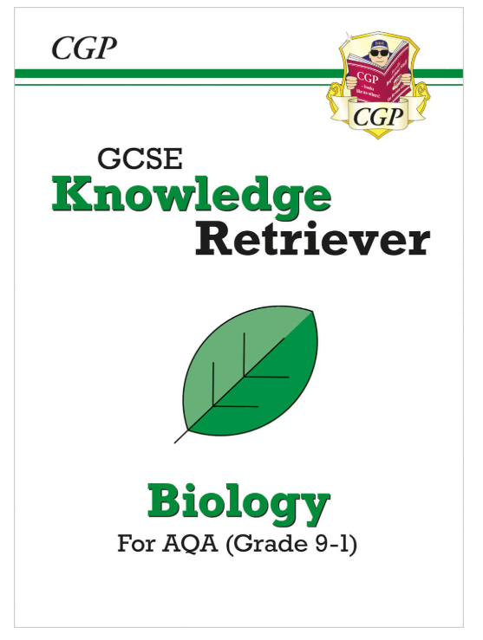
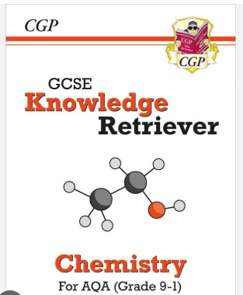

Revision guides
GCSE Combined Science AQA
Higher or Foundation Complete Revision & Practice - £12
GCSE Biology and Chemistry and Physics AQA
Complete Revision & Practice - £6 Each
GCSE Combined Science AQA
Knowledge Organiser & Retriever Bundle
Higher or Foundation £7.50
GCSE Biology, Chemistry, Physics AQA
Knowledge Organiser & Retriever Bundle – £4.25 Each

Slide 10
Past paper/ exam style questions
Try to answer:
  Exam conditions
  Open book
Questions to test your understanding.
Mark them using the mark scheme.
Correct them to learn from them.
If you got it wrong work out why!
Notes:
Go through why it is important to work out why you got things wrong.

Slide 11
What next…
Check your login to MyGCSEScience and Seneca work.
Make sure you have a revision guide… take the money to a Science Technician) or your teacher.
Use the revision plan to keep yourself organised.
Make the most of every Science lesson and intervention session you have.
Attend Thursday after school revision sessions.
Any further questions, please do not hesitate to ask or email
Dr King: 4179kk@mysnhs.net or your Science teacher(s).

