Slide 2
Y11 GCSE Revision Evening
Mrs D London-Hill

Slide 3
Aims for this evening
Provide a brief overview of the Y11 GCSE exams process with key dates.
Sixth Form at Sturminster Newton High School
To outline expectations of students
To provide guidance on how you can support your child in:
English
Maths
Science
Suggest ways in which parents can support students to reach their full potential

Slide 4
Key Contacts
Miss K Allen – Head of Year 11
Mrs S Hoffman – SENDCo
Ms S Noel – Exams Officer
Mr P Dodman – Careers Lead
Mr S Ling – Head of Sixth Form
Dr K King – Head of Science
Mrs K Collins – Head of English
Mr R Cunningham – Head of Maths
All contactable on: office@mysnhs.net

Slide 5
Key Dates – GCSE Roadmap 2024
Date | Event
29th January – 2nd February | Post-16 Subject Taster Week
5th – 9th February | Statement of Entry sent home – Please check!
26th – 30th February | Year 11 Progress Exams 2 (Mocks)
Spring Term | Post-16 Futures Meetings (optional on request)
18th - 22nd March | Year 11 Progress Exams 3 (Mocks)
25th -29th March | Exam timetables sent home – Please check!
Mid-May | Written GCSE Exams begin
Mid June | Written GCSE Exams end
July | Year 11 Prom
22nd August | GCSE Results Day and Sixth Form Sign-up

Slide 6
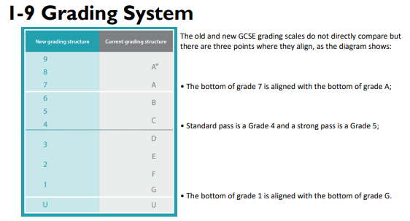

Slide 7
Target Grades
Students KS2 scaled scores in English and Mathematics are used to generate targets in conjunction with a nationally approved organisation called the Fischer Family Trust (FFT).
All students are set an initial target for every subject. If a student consistently meets their target this will be adjusted upwards so that all students have an aspirational target to work towards.
Performance compared with targets to allow progress to be monitored by students, parents and staff.

Slide 8
Sturminster Newton Sixth Form
Sixth Form Team – Mr Ling, Mrs Gilmore, Mrs Privett
Young people are required to remain in school, training or work-place training until the age of 18.
If you would like a ‘Futures meeting’ with the Head of Sixth Form to explore the post-16 options for your young person, please email: office@mysnsh.net

Slide 9
Being successful in Y11 – We are a partnership!
Ensuring success
Raising aspirations
Unlocking potential

Slide 10
Attendance
Research suggests that 17 days missed from school equates to a whole GCSE grade (that’s 91% attendance)
Students with 100% attendance:
2.2 times more likely to achieve
5+ GCSEs Grade 4-9 or equivalent
including English and Maths.

Slide 11
Engaging with intervention
Students that engage with academic support and intervention on average achieve over half a grade higher than their target grade.

Slide 12
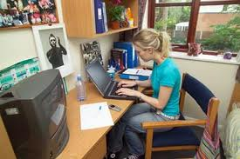
Role of the parent
Help them to get organised
Create a good working environment
Organised desk
Revision timetable and dates for deadlines
Books, resources and revision guides
Useful “facts” posters on the walls
Clock
Drinks and snacks space
Quiet- no distractions!

Slide 14
Revision & Exam Preparation
Start NOW!
Ensure they have all the necessary equipment and revision guides/materials
Recognise their strengths but keep your expectations high
Recognise areas for development and make sure the expectations are manageable for all of you and high
Keep in touch – with subject teachers, and tutors

Slide 15
Revision & Exam preparation

Slide 16
Helpful Apps & Websites

Slide 17
Where to go next:
Session | Subject
1 | English (Mrs K Collins, Rm 16)
2 | Maths (Mr S Miller, Photography room)
3 | Science (Dr K King, Art Room)

